Slide 1


Slide 2





















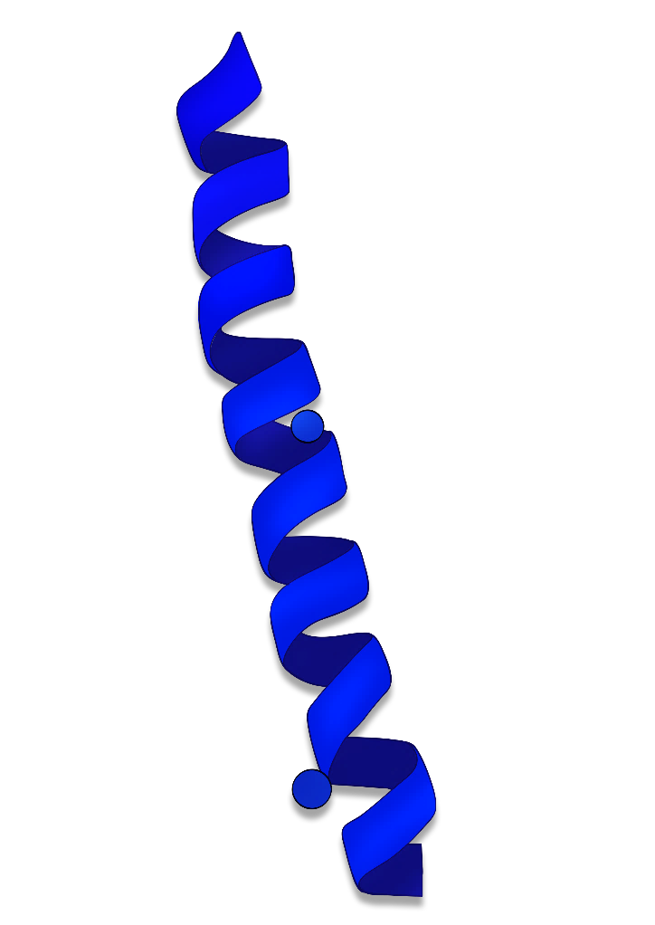


KMUTT
SUSTAINABLE REPLACEMENT OF ANTIBIOTICS AND PRESERVATIVES
Innovation
King Mongkut's University of Technology Thonburi
Bangkok, Thailand
INNOVATION OF RECOMBINANT HUMAN PEPTIDE

Slide 3
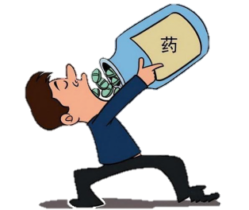
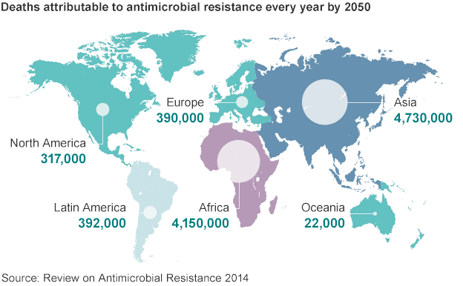

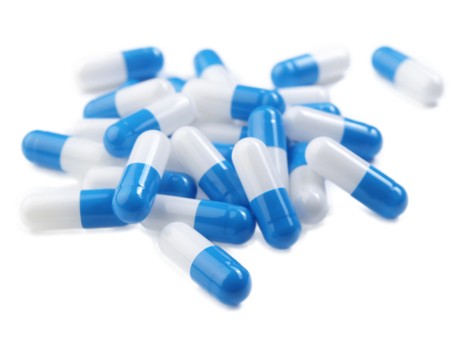



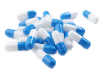
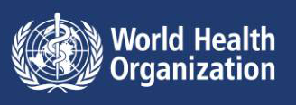
Challenging issues
on antibiotics usage
Antibiotic resistance infection bacterial
In hospital
$55 billion health care costs
10,000,000 death per year
A Return to the Dark Age of Medicine ?
Antibiotic
resistance
Antibiotics
In agriculture

Slide 4
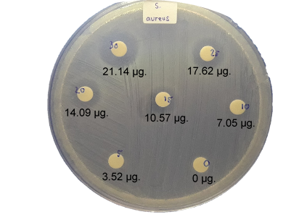
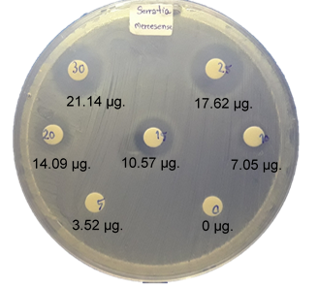
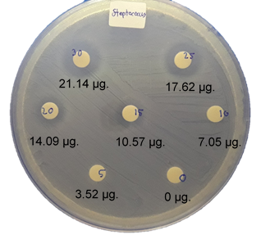
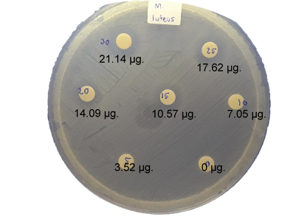


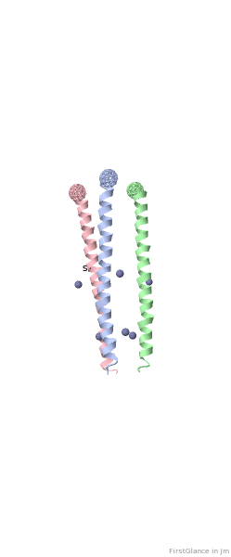
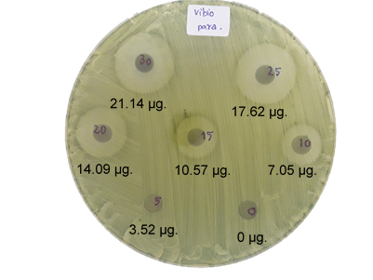
Alternative to antibiotics
Dermatological industry
Value proposition
to partner/customer
Peptide biomolecule
Animal feed industry
Found naturally
in our body
Agar well diffusion method
*Clear zone : bacteria have not grown.

Slide 5






Production
of recombinant human peptide
Gene design and synthesis
Production in bacteria
Antimicrobial activity

Slide 6

Mechanism
of recombinant human peptide

Slide 7
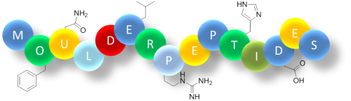


Gene design and synthesis
Our Method
Gene
Gene
Human peptide
Human peptide
Production
in bacteria
Put gene into bacteria
Our Method
Put gene into bacteria
Other Methods
Peptide Activation
Active Human peptide
Use chemical or enzyme for reactive
Active peptide
Active Human peptide

Slide 8


Cost of production
Price of peptides produced by other processes
$469
$1,869
Price of our innovation by protein engineering

Slide 9










Competitive advantages of innovation
01
02
Consumers
03
Drug resistance
Environmental friendly
Non-chemical
avoidance
Probiotics
Antibiotics
biomolecule
acceptance
Preservatives
Nisin A
Human safety
Low possibility
unlikely
Affordable
Human safety
Environmental friendly
Affordable
04
05
Human peptide
Bacterial
inhibition
Non-chemical biomolecule
Gram +/– bacterial inhibition
Avoidance of drug resistance and trade barrier
Acceptance concerning consumers
Low possibility unpleasant immune response

Slide 10


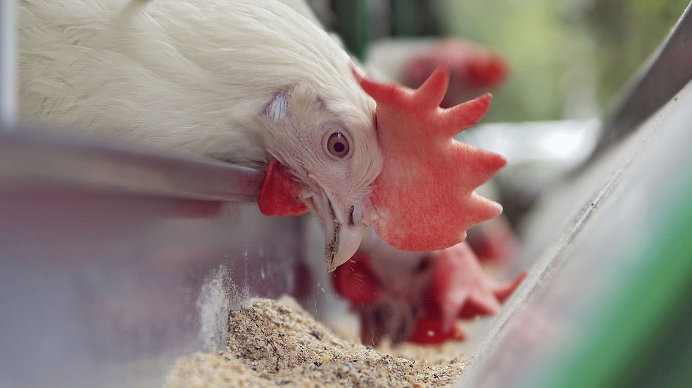




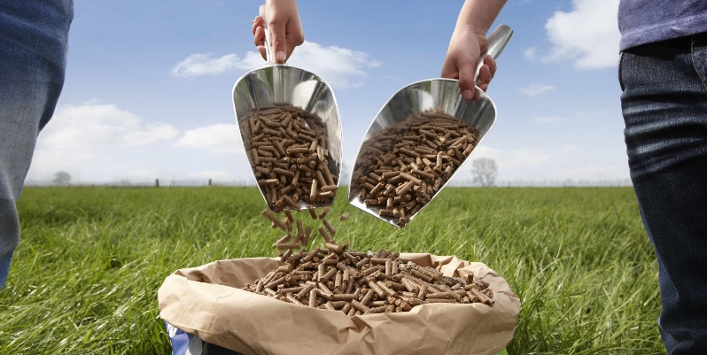

Potential applications in industries
Antibiotic free topical drugs
Replace less safety peptide
Antibiotic free animal feed

Slide 11





Marketing strategies
Sustainable replacement of antibiotic and preservatives
End users
Manufacturing/
agricultural business
Business
partners
(high-value product)
Inventors
Enlarged production scale of the innovation
Publicize the innovation business pitching
Consumer who awareness of healthy lifestyle
Technical supports for the innovation applications

Slide 12
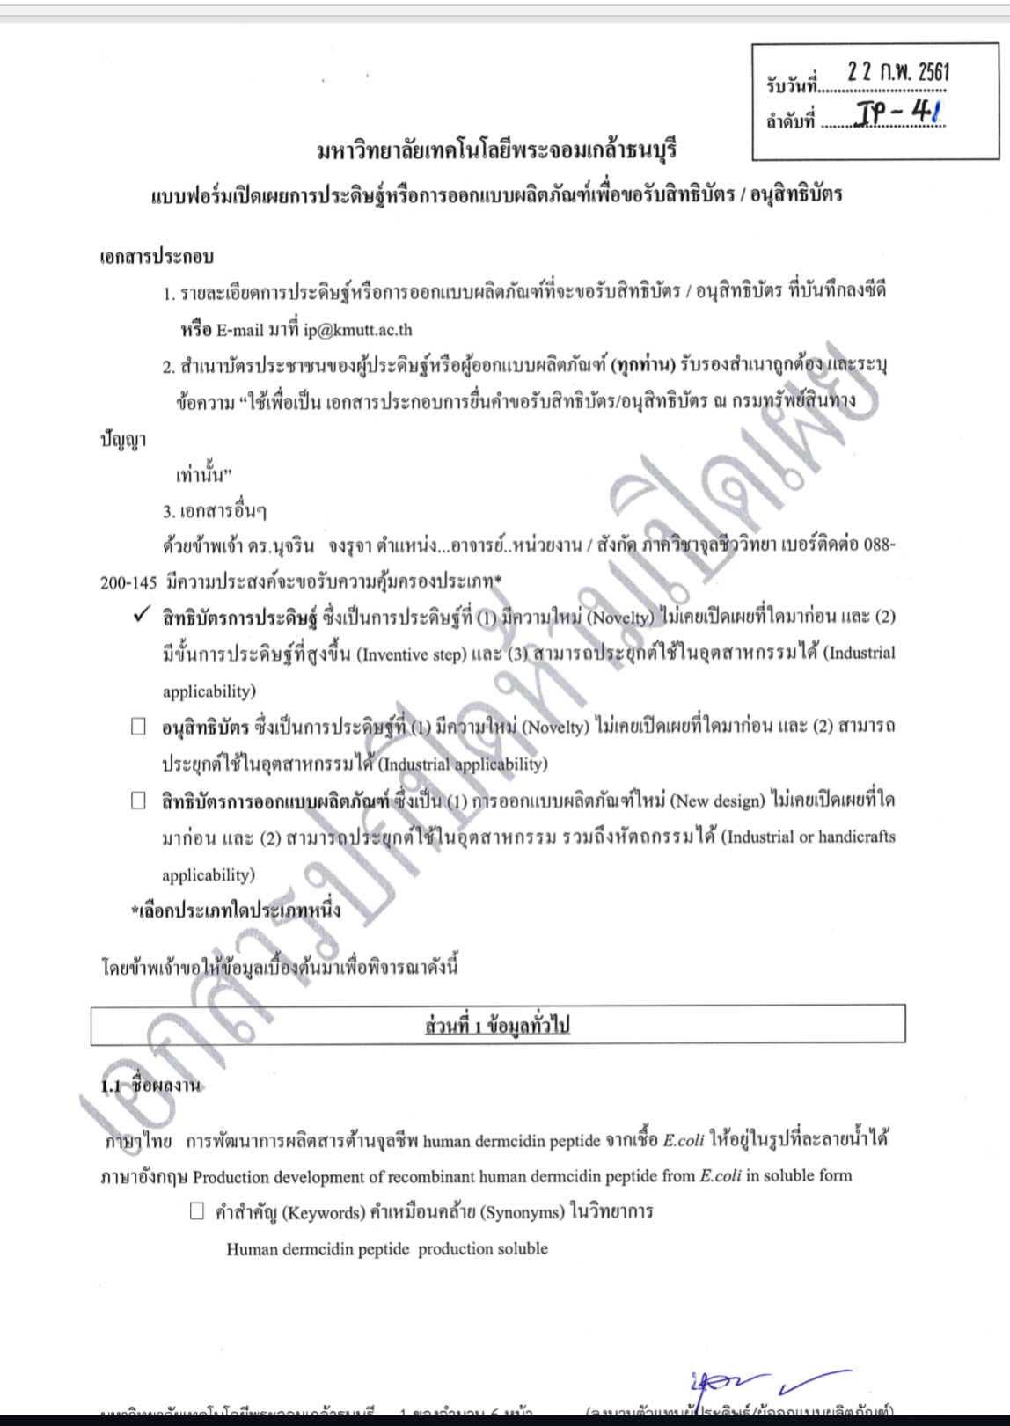


Continue to market strategy
Thai Patent submitted in process

Slide 13
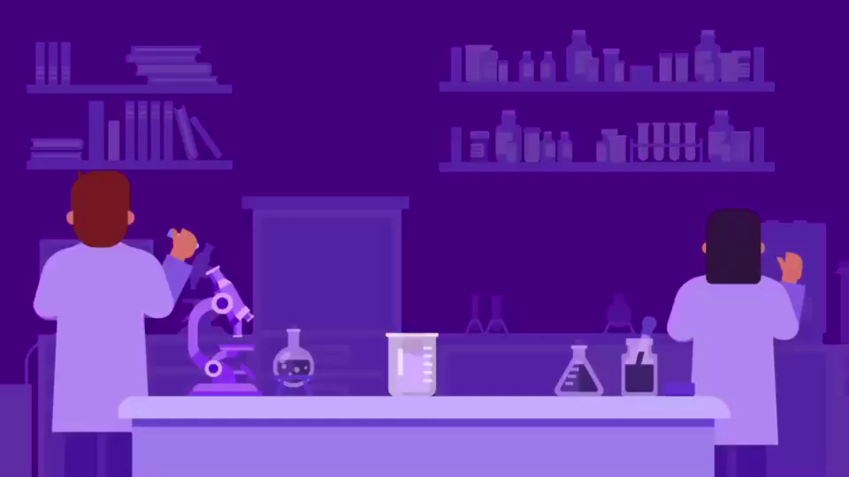

Slide 14
